Slide 1

Mini module 3: Color and Waves
Learning Outcomes:
Connect information about waves with color
Waves have two key features: height (amplitude) and wavelength (frequency)
Wavelength directly corresponds with energy and color
Waves, Energy and Color Model:
https://colab.research.google.com/drive/1T24gHsLOOBCJUwu2G1s1YmwRjSd5Yccd?usp=sharing
This material was developed as part of a grant received from the National Science Foundation, Award Number 1905734
Notes:
Resources:
https://blog.feslighting.com/incandescent-vs-led#:~:text=LEDs%20operate%20at%20an%20impressive,only%2010%2D20%25%20efficient.
https://www.thelightbulb.co.uk/resources/ultimate-guide-led-lights-leds-vs-incandescent-lights/
https://cen.acs.org/materials/inorganic-chemistry/chemical-search-better-white-light/96/i46

Slide 2
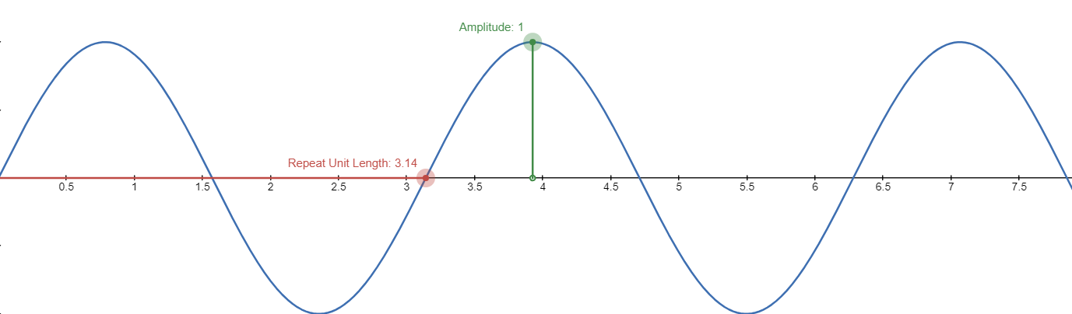
What defines a wave?
Amplitude:
The “size” of a wave
Wavelength:
How long it takes for the wave to repeat
Play with waves yourself
Notes:
More applets: https://phet.colorado.edu/sims/html/wave-on-a-string/latest/wave-on-a-string_all.html

Slide 3
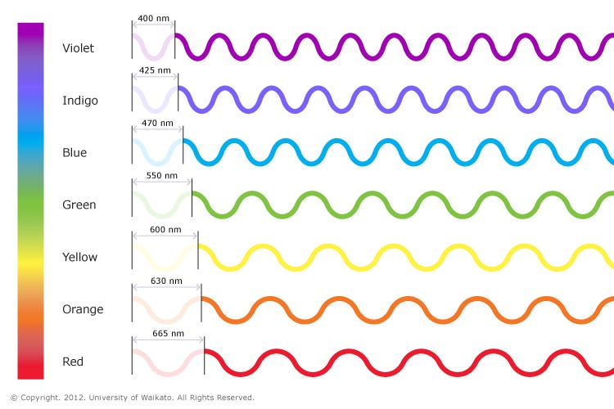
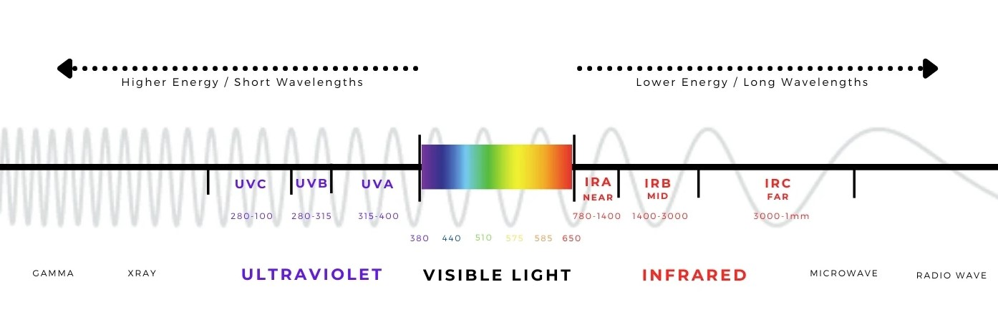
Color and Wavelength
Wavelength is the only determining factor in the color we see
As the wavelength gets longer the color becomes more and more red
As the wavelength gets longer the energy decreases (referred to as red shifting)

Slide 4
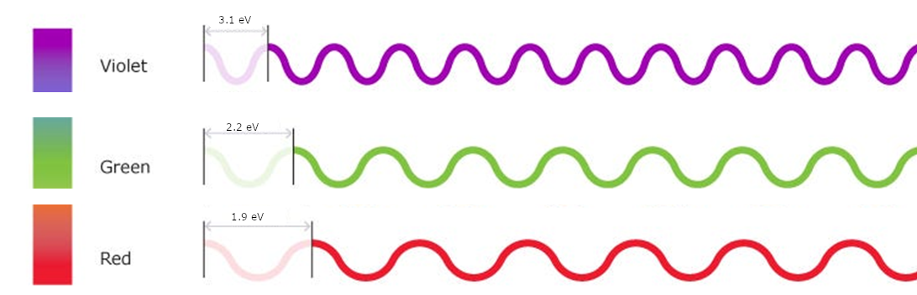
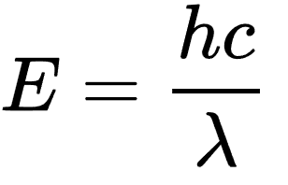
Color, Wavelength and Energy
Wavelength (λ)
Energy (eV)
Planck's Constant: h = 6.5 * 10⁻¹⁶ eV*s
Speed of Light: c = 3 * 10⁸ m*s⁻¹

Slide 5
Example questions
Red in a cell phone display has 650 nm wavelength. What is the energy associated with this wavelength?
Blue in a cell phone display has 400 nm wavelength. What is the energy associated with this wavelength?
A color is associated with 2.5 eV energy. What is the wavelength and color?

